Slide 1
Introduction to J2EE

Slide 2
What Is J2EE
Java 2 Enterprise Edition
There are 3 different specifications within the Java framework (J2SE, J2ME, J2EE)
Created to provide a simple, unified standard for distributed applications through a component based application model
Specification is managed by a consortium of industry leaders

Slide 3
What’s Included
Supports:
  HTTP/HTTPS
  EJB 2.0
  Servlets 2.3
  JSP 1.2
  JMS 1.0.2
  Connector 1.0
  JDBC 2.0
  Java Transaction API(JTA) 1.0
  JavaMail 1.2
  Java API for XML Parsing (JAXP) 1.1

Slide 4
More stuff included - tools
Administration Tool
Application Deployment Tool
Key Tool
Verifier
Packager
Cleanup Script

Slide 5
EJB 2.0
Really called: J2EE SDK 1.3_01
What’s new:
  Java Messaging Service (JMS)
  J2EE Connector Architecture
  Java API for XML Parsing (JAXP)
  Servlet enhancements
  JSP enhancements
  EJB enhancements
    Message Beans
    enhanced CMP

Slide 6
Introduction to distributed architectures
Applications are divided into components depending on function
Components can also be physically separated
Different layers of application are loosely coupled
How J2EE is different than MS .NET

Slide 7
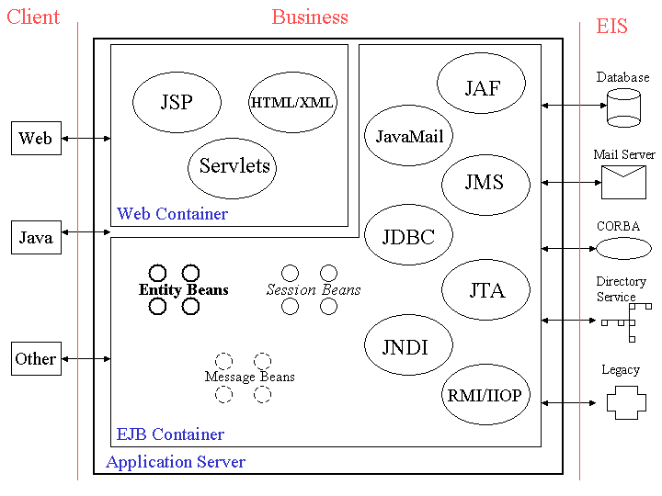
Typical J2EE Architecture

Slide 8
Why Use Distributed Architectures/J2EE?
Efficient Utilization of System Resources
  Scalability/Availability
  Maintainability
Easy Development
Quickly Becoming Industry Standard
  Ensures support from tool vendors and component providers
  Protects our IT investment
  Excellent support resources available
  Positions companies for future

Slide 9
Typical J2EE Architecture

Slide 10
N-Tier Architecture
Designed to keep elements of a system in distinct logical units
The Tiers are
  Client
  Web
  Business
  EIS

Slide 11
Typical J2EE Architecture

Slide 12
EJB Container
A container is provided by the Application Server vendor to provide basic services that are required by J2EE specification.
An EJB programmer places their code here, and is assured a variety of basic services are available
This means the developer doesn’t have to code these services from scratch
Specification states which services must be supported but not how

Slide 13
Basic Services Supplied by the EJB Container
Security
Transaction management
Remote Client Connectivity
Life Cycle Management
Database Connection Pooling

Slide 14
More Services provided by container
The following basic services will be supported by all J2EE compliant products
  RMI/RMI-IIOP
  Transactions
  Security
  Resource Pooling
  Thread Control
  Presentation Logic
  Persistence
  Messaging
  And more…

Slide 15
Typical J2EE Architecture

Slide 16
Client Components
User interface allowing interaction with business logic
Examples
  Applications/Applets
  Servlets/JSP
  Web Browsers (HTML/XML)
  Others

Slide 17
Web Container
Services supported by the web container
  HTTP
  JSP
  Servlets

Slide 18
Typical J2EE Architecture

Slide 19
Business Components
Logic that solves or meets the needs of a particular business domain
Examples
  User Verification
  Query Creation
  Message Logging

Slide 20
Types of EJB’s
EnterpriseJavaBeans aren’t JavaBeans
Session Beans
  Stateful
  Stateless
Entity Beans
  Bean Managed Persistence
  Container Managed Persistence
Message Beans

Slide 21
Typical J2EE Architecture

Slide 22
EIS Layer
This is where you keep the data that is integral to your system
Examples
  Database
  ERP Software (such as SAP or Peoplesoft)
  Other Legacy Applications

Slide 23
Development Roles
Roles allow developer to concentrate on areas of expertise
No More Stovepipes!
Roles:
  J2EE Product Provider
  Tool Provider
  Application Component Provider
  Application Assembler
  Deployer
  System Administrator

Slide 24
More Information
http://java.sun.com/j2ee
http://www.theserverside.com
http://www.developerworks.com
http://www.precisejava.com

Slide 25
Recommended Reading
Java Server Programming J2EE Edition; WROX Press
J2EE Applications and BEA WebLogic Server; Prentice Hall
Designing Enterprise Applications with the Java 2 Platform, Enterprise Edition; Addison Wesley

